Slide 1
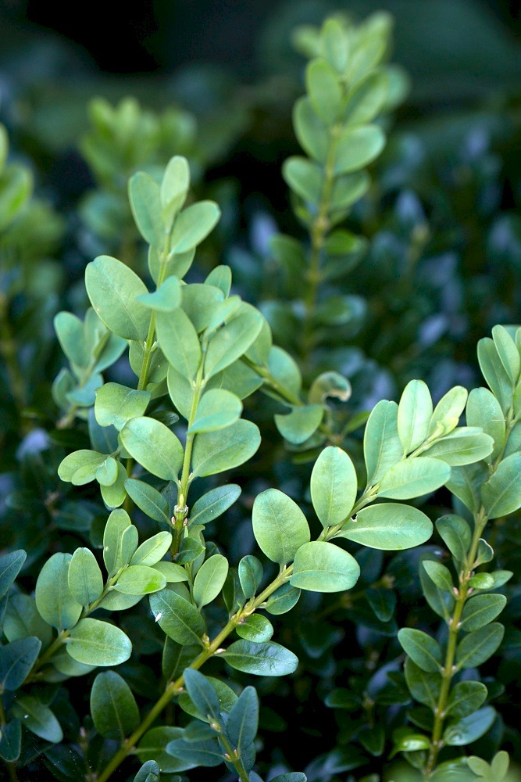

The Plant Microbiome and How to Study It with High Throughput Sequencing
Xiaoping Li, PhD
Virginia Tech Hampton Roads AREC
Feb 12, 2021
Notes:
Good to see y’all here today and thank you for the support for my first talk after joining the BBIG team. First of all, I would like to thank Dr. Hong and the microbiome scientist search committee gave me this opportunity to be part of the boxwood phyllosphere microbiome project and I am glad to meet so many talented people on the team
Microbiome is a fast-moving field, especially with newer sequencing technologies and platforms .
So that’s the purpose of my talk today, to take you onboard of plant microbiome study, so you will have a better idea of what I will be doing in the boxwood microbiome project. Again the topic is not about my project. But there will be presentations and talks about the project as it is moving on and producing results. We will keep you informed.

Slide 2
The outline
The plant environment.
The phyllosphere
The rhizosphere
The phyllosphere microbiome.
Characteristics
Altering factors
Link to plant health
How do we study microbial community?
High though-put sequencing
The future directions
Notes:
my talk today is gonna cover 4 parts, we first start with what is the plant environment, then dive into the phyllosphere microbiome, then we gonna talked about using high throughput sequencing to study microbiome, lastly, we touch on the future direction of microbiome studies.

Slide 3

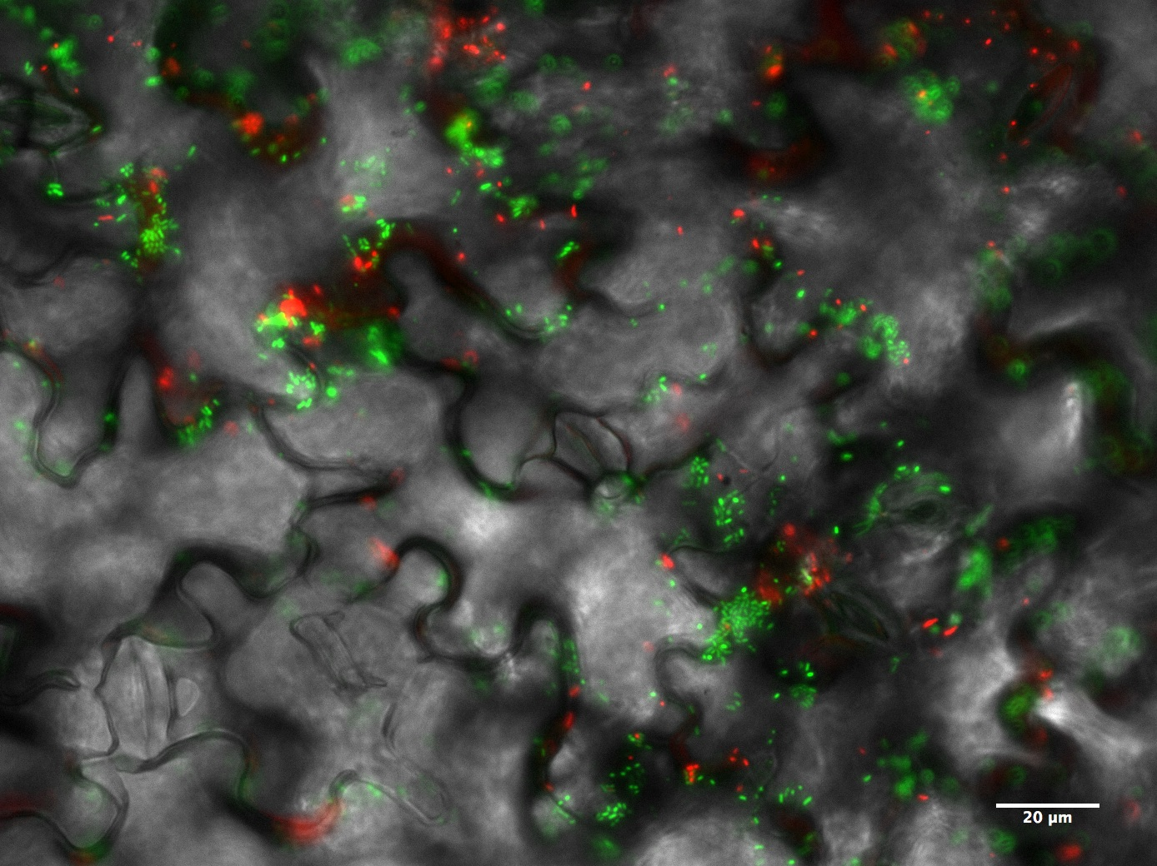
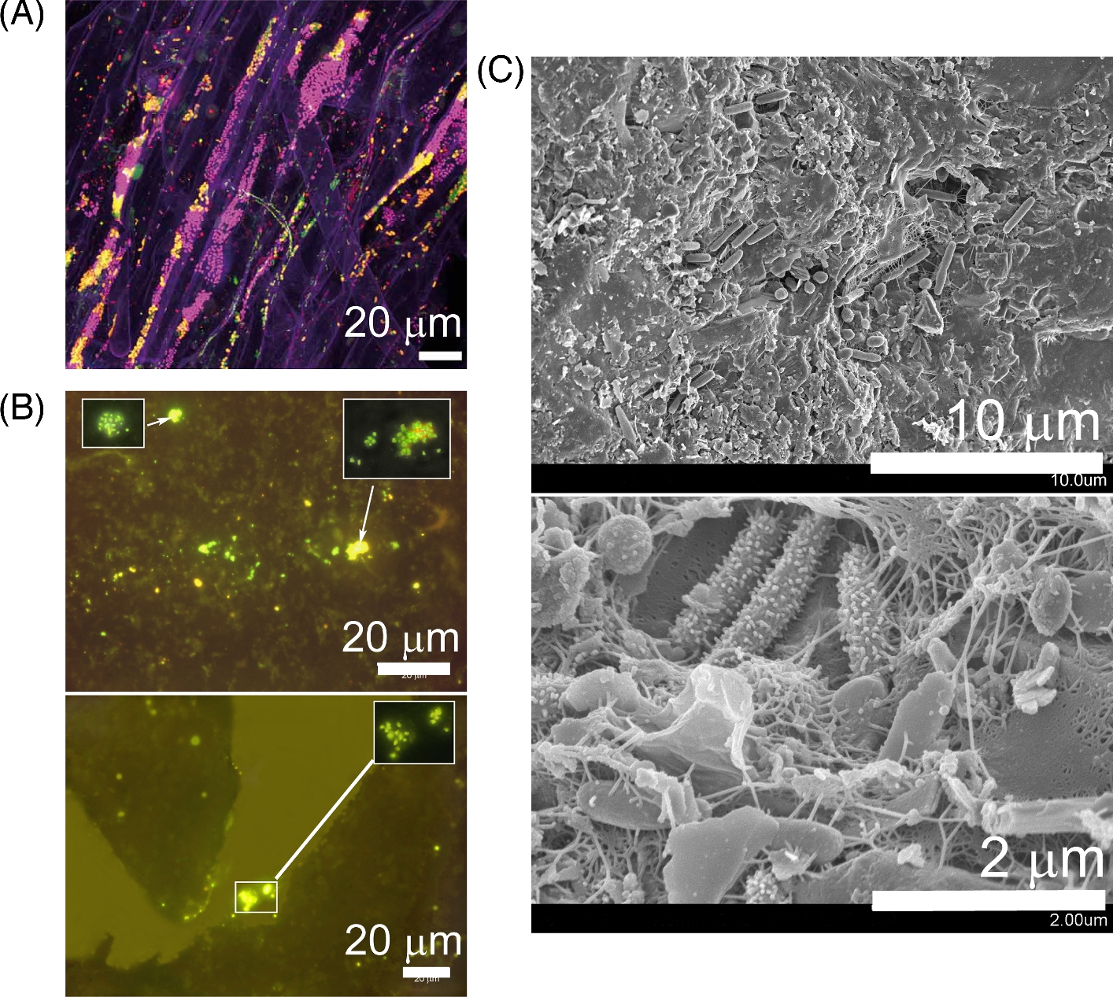
The plant environment
Rhizosphere – the below ground part of the plant, the interface to the roots
Phyllosphere – the above ground part of the plant
Leaves
Stems
Flowers
Fruits
Pollens
Nectar
Seeds
Colonized by microorganisms
Large quantities
Diverse
Microbiome - The assembly of microbiota and their activities
Phyllosphere
Bacteria
Fungi
Viruses
Protists
Rhizosphere
Algae
Nematodes
Notes:
cardinatel 2014 rhizosphere microscopic image
######################################
We are no strangers to the terrestrial plants, plant organs such as roots are extending in the soils and plant organs such as leaves, stems, flowers are shooting up above the soils and exposed to the surro. The plant organs and their surrounding environments constitute the plant environment. We classify this environment into two general spheres.
The one below the ground near to the roots is called the rhizosphere, and the other one is called the phyllosphere, referring to the plant ariel parts above the ground.
Microorganisms can colonize those two spheres and they exist in large quantities, they are diverse.
The assembly of the microbial communities and their activities in the plant enviroment is termed plant microbiome.

Slide 4
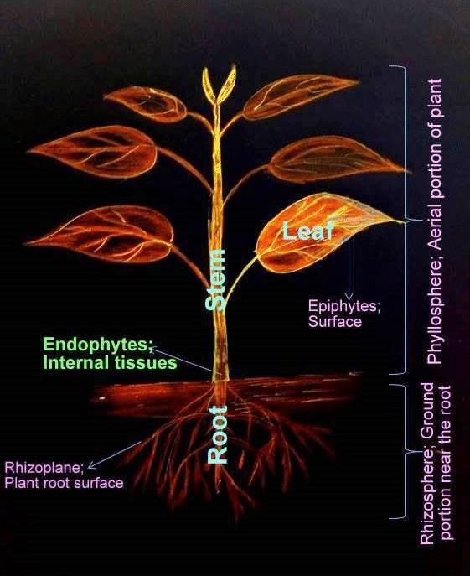
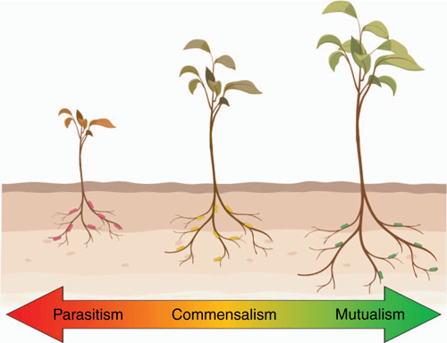
The plant environment cont’d
Epiphytes – microorganisms live on the surface of a plant
Endophytes – microorganisms live in the plant tissues
leaf endophytes
root endophytes
Epiphytes can also become endophytes
Those microbes establish complex relationships with their plant hosts:
Parasitism – plant pathogens
Mutualism – plant growth promotion, alleviate stresses, etc.
Commensalism – do not cause harm to the plant host. Interact with other microbes/functional redundancy
Notes:
additionally, those microbes live on the surface of a plant are called epiphytes
In contrast, those live in the plant tissues are called endophytes. Not only can you find endophytes in plant leaves also in roots and other plant parts.
Sometimes, epiphytes can get into the plant tissue and become endophytes.
The colonizing microorganisms form complex relationships with their plant hosts. These relationships include parasitism (plant pathogens causing diseases in a plant).
Some microorganisms can benefit the plant host
Majority of them do not cause harm nor benefits to the plant host. The reason for their existence not clear yet, maybe they can help other microorganism to establish colonization or they are needed for functional redundancy etc

Slide 5
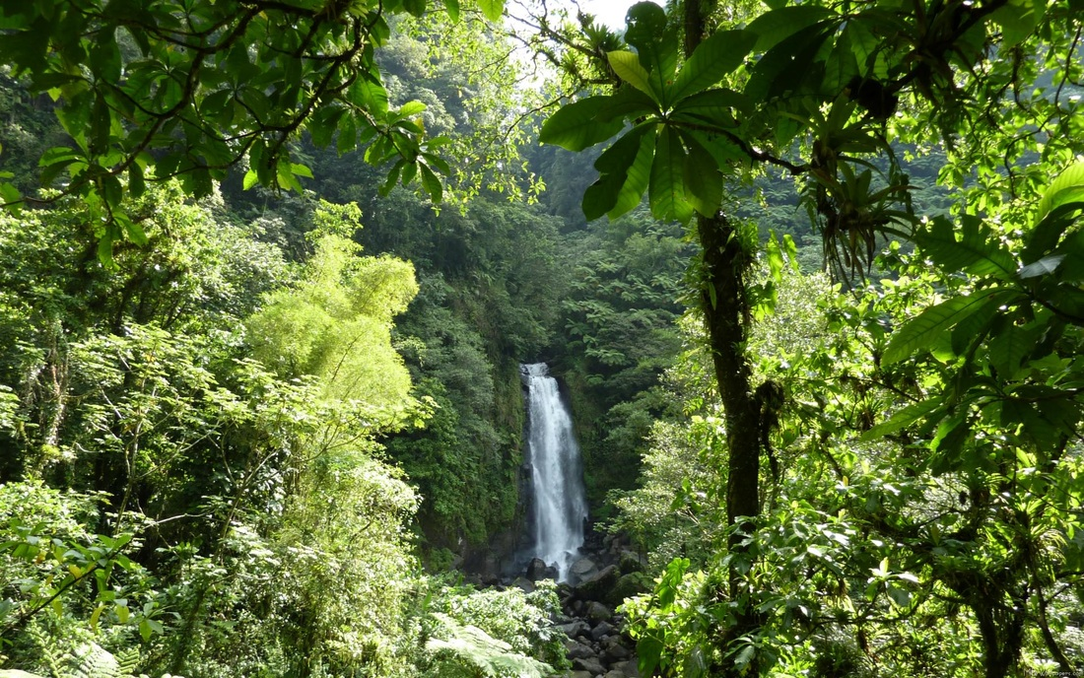
The phyllosphere microbiome
The phyllosphere microbiota is often referred to the foliar epiphytes (Leveau J.HJ., 2019)
Leaves make up most of the terrestrial plant aerial surface area (6.4 x 10⁸ km²) (Morris C.E. et al., 2002)
Provide vast habitats for microbial colonization
Diverse microbial community
Bacteria, fungi, yeasts, protists, algae, and bacteriophages
Dominated by bacteria. Planetary phyllosphere bacterial population: ~ 10²⁶ cells (Morris C.E. et al., 2002)
Notes:
In this talk, I am gonna zoom in on the phyllosphere microbiome, specifically the leaf epiphytes, because phyllosphere microbiome is loosely referred as the folia epiphytes in a lot of studies.
Those studies investigated leaves microbiome because leaves make up most of the plant surface area, and they provide vast habitats for the microbes to colonize.
Simiarly, the leaf dwellers are also diverse
However, bacteria are usually the dominant microbes you’d find on the phyllosphere

Slide 6
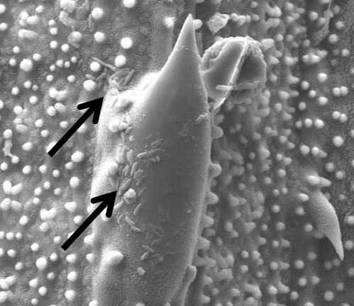
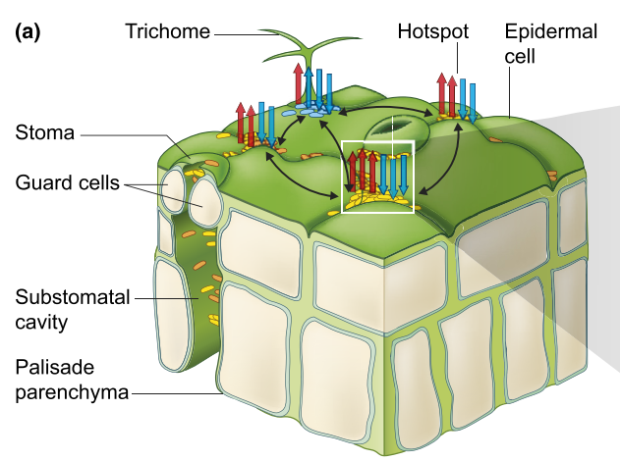
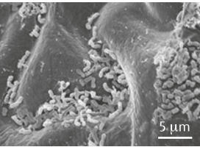
The characteristics of leaf epiphytes
Bacterial colonies favorably aggregate in large groups on leaf surface (Morris C.E., et al., 1997)
hotspots – bases of trichome, stromata, grooves of veins, junctions of epidermal cells
water retention
nutrient leaching
metabolites secretion
In contrast, fungi are found as solitary
cells or small groups of cells (Andrews J.H.,
et al., 2002)
Thapa S. et al, 2018
Vorholt j., 2012
Remus-Emsermann M. et al., 2018
Notes:
Permeation plays an important role in the growth and survival of epiphytes by allowing leaching of water and compounds to the phyllosphere.
stromata are pores regulate gas exchange and transpiration
glandular trichomes are secretion organs that release a wide spectrum of exudates. Non-glandular trichomes provides water retention, absorption, light reflection, reduce heat and radiation.
#################################################
When we zoom in on a leaf surface, we find that bacteria communities are not evenly distributed. Rather, they are dwelling on some particular “hotspots” as large aggregates, such as the bases of trichome, stromata, grooves of the veins, conjunctions of epidermal cells.
The reasons they prefer gathering in those places are because the leaf surface is a pretty harsh and nutrient limited environment., the bacteria need water, nutrients and metabolites to grow or to propagate. Those spots provide an ideal niche for them to survive out there. For example, grandular trichomes can secret a wide spectrum of exudates that the microbes can utilize as their nutrient source.
In contrast to bacteria community, fungi are found as solitary cells or they are in small group of cells.

Slide 7
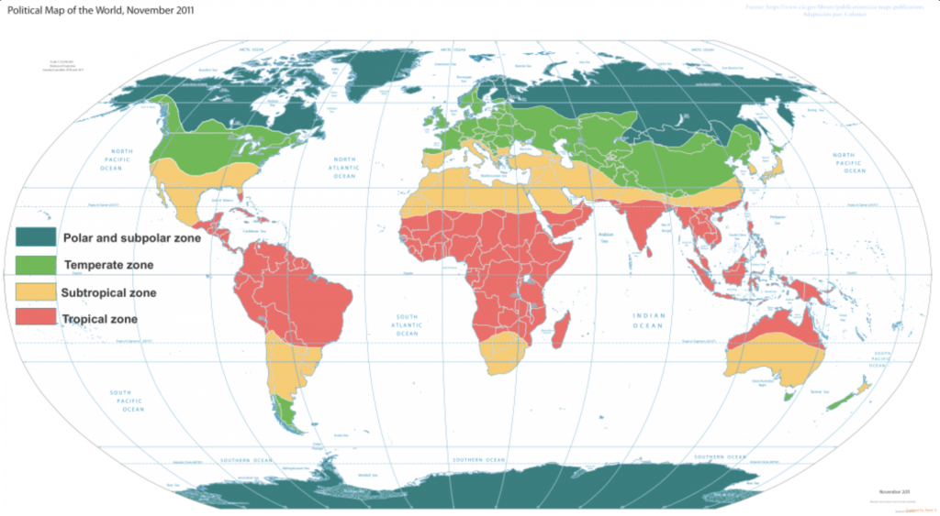












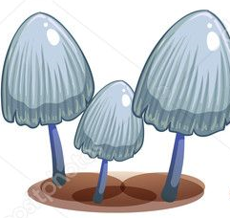











The community composition
The phyllosphere fungal communities are very diverse in temperate region and on the tropical trees
The phyllosphere bacteria communities are substantially diverse in the temperate, subtropical and tropical regions
But the phyllosphere microbial communities are less diverse than in the soil and the rhizosphere.
Notes:
So globally, the phyllosphere fungal communities are hypervariable in the temperate region, and their diversity is quite higher in the tropical trees.
On the other hand, the diversity of the phyllosphere bacterial communities are very rich in the temperate, subtropical and tropical regions

Slide 8
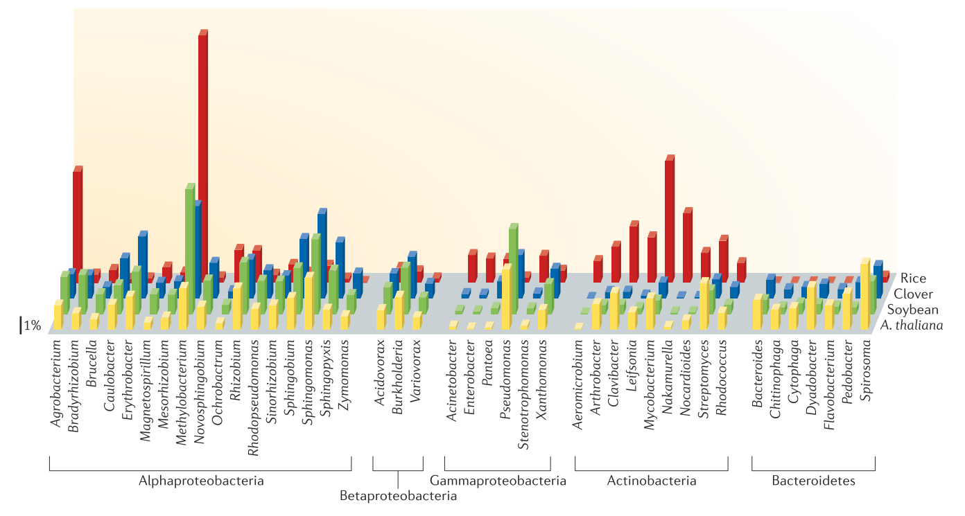
The community composition cont’d
Common bacteria
Common fungi
Proteobacteria
Alphaproteobacteria
Gammaproteobacteria
Actinobacteria
Bacteroidetes
Firmicutes
Human pathogenic bacteria i.e. Salmonella enterica, Escherichia coli, etc
Ascomycota
Yeasts that belong to Ascomycota & Basidiomycota
fungi-like
Oomycota, water molds and downy mildews, such as phytophthora spp.
Phyllosphere microbial communities are temporally and spatially diverse!
Notes:
In general, the phyllosphere bacterial communities are dominated by
Proteobacteria, That include alpha proteobacteria and gammaproteobacterial, betaproteobacteria are less abundant
Actinobacteria,
Bacteroidetes,
Firmicutes, and sometimes human pathogens such as Salmonella enterica, Escherichia coli are pretty common dwellers.
On the other hand, the most common fungi you would find in the phyllosphere are the filamentous fungi, followed by yeasts. Most of them are from phyla Ascomycota and Basidiomycota
Also fungi-like oomycota can be found in the phyllosphere as well, such as phytophthora spp.
The phyllosphere microbiome is temporally and spatially diverse. That leads us to the next topic: what factors influence the phyllosphere microbial communities.

Slide 9








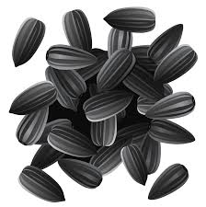




The drivers altering the communities
Abiotic factors:
Agricultural management
Climate
Soil types and properties
leaf
immigration
flower
emigration
pollen
Biotic factors:
nectar
Insects
Succession
Seeds
Microbial interactions
Herbivore and phytopathogen
Plant species
Notes:
There are multiple drivers that play important roles in regulating the immigration, the succession, and the emigration of the microbial colonizers in the phyllosphere.
In general, we classify them into abiotic and biotic factors.
Abiotic factors, climate of a location is a huge factor affecting the microbial community, a heavy rain can wash off a large amount of the microbial colonizers.
agricultural management, soil types and properties also have important contribution to reshape the phyllosphere microbiome.
On the other hand, Biotic factors include seeds, plant genotypes and plant growth status, herbivore/pollinator, plant pathogens, also microbe-microbe interactions can introduce, select for, or eliminate microbes in the phyllosphere.

Slide 10

Links to plant health
Plant growth promotion
Plant protection
Plant hormones
Abiotic stress tolerance
Nutrient acquisition
Antimicrobial compounds
Pollinator attractions
Compete with pathogens
Suppress insect pests
Notes:
How do phyllosphere microbes link to plant health?
Broadly, they can influence the plant health via two aspects, one is associated with plant growth:
The microbes can promote plant growth by synthesizing phytohormones (IAA indole-3-acetic acid, cytokinin) #produce plant hormones (IAA(auxin) – coordinate growth, cytokinin – promote cell division in plant roots and shots)
They also involve in the nutrient cycling, for example, they have important functions in nitrogen fixing
floral microbiome has shown to enhance the flower attraction to pollinators by producing volatile compounds
At the same time, the phyllosphere microbiome can confer plant protections for one, it can alleviate abiotic stress
For example, some phyllosphere microbes can produce biosurfactant to increase the leaf surface wettability thus alleviate the drought stress; Some microbes can express antifreeze proteins to protect the plant from frost.
The microbes can also produce antimicrobial compounds or they can compete with the pathogens for the niche enviroment. Therefore those microbes have potential to control plant diseases, In recent years, there are a lot of studies focusing on identifying potential biocontrol agents picking from the plant microbiome.
Not only the phyllosphere microbiome can help the plant to attract pollinator, the microbes can also suppress insects via secretion of toxins, or modulate plant defense systems to convey suppressions against pests.
Therefore, we see that why the plant microbiome including phyllosphere microbiome has become an important research area in agriculture and horticulture. Because ultimately, it provides us a key to address challenging issues such as sustainable agriculture, chemical pollutions and food safety.

Slide 11
Study methods
Microbiome study
Culture-based
Microscopy
Culture-independent (i.e. sequencing)
Pro: In Situ, real time, individual
Con: need expertise, focus on a few microbes
Pro: cheap, isolation and identification, functional profile
Con: unculturable communities (99%), time consuming and laborious
Pro: quick identification and functional inference at community scale
can be costly, mis-identification inflated
The new big questions:
Who’s there?
What are they doing?
How can we manipulate them?
Notes:
So far we have learned a bit about the plant environment and the phyllosphere microbiome, then question is how do we study them. Currently, there are 3 common methods to study microbiome: microscopy, culture the microorganisms, and the third one is culture-independent approach via sequencing the DNA from your samples.
For each approach, There are pros and cons. For example in the study of soil microbiome, although culture based methods are very cheap, but it can not represent the whole microbial community because 99% of soil microorganisms are un-culturable.
Therefore today, we are focusing on culture-independent method because it generates community scale data which can help us answer the new big questions:

Slide 12


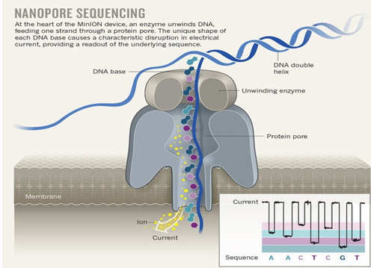
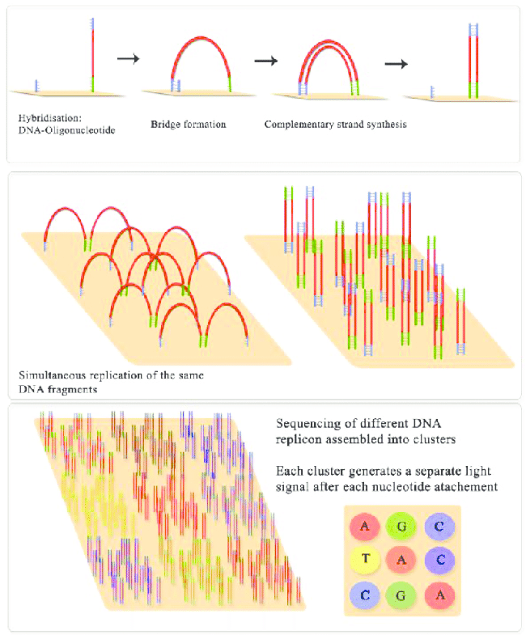

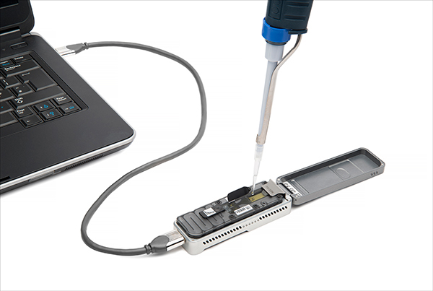

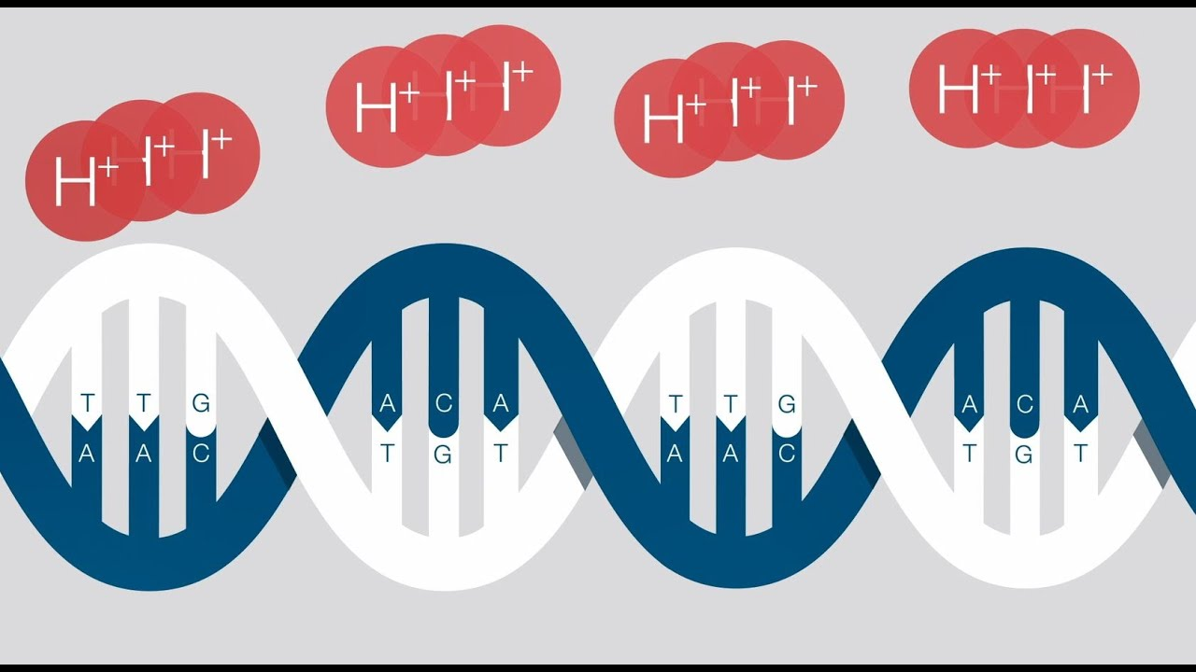

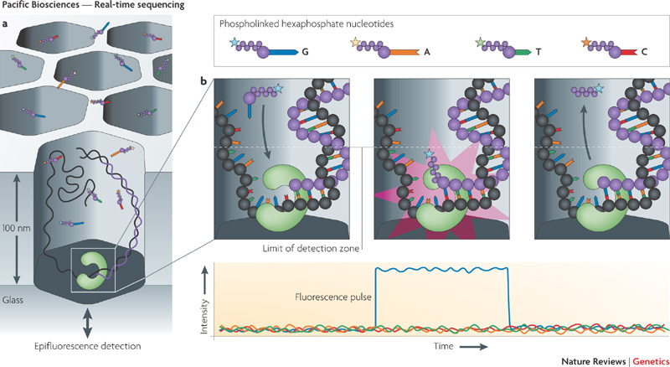
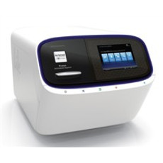
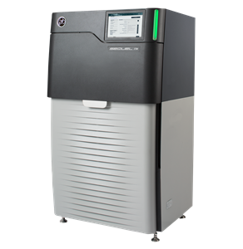
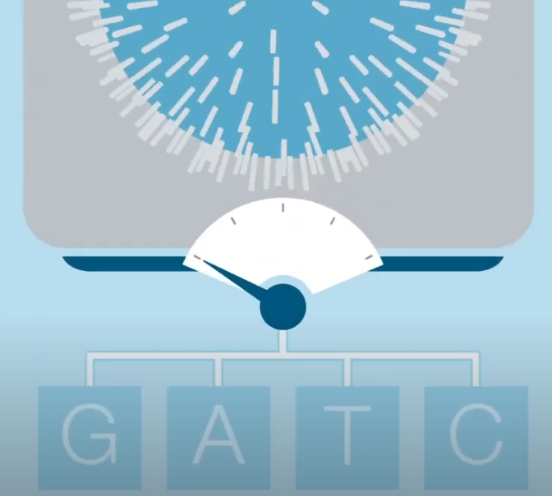
High Throughput Sequencing
Notes:
miseq 0.3–15 Gb 1-96 samples per-run 1-25 mil reads 2x300
minion up to 30Gb of data. 100kb
###########################################
nowdays, there are 4 popular sequencing platforms, illumina and ion torrent are coined the second generation sequencing or the next generation sequencing. These platforms are based on sequencing by DNA synthesis.
on the other hand,
Nanopore sequencing and pacbio SMRT sequencing are the third-generation sequencing platforms. They can perform single molecular and real time sequencing, and are capable of generating long reads. Last couple of years, MinION from Nanopore has gain huge popularity because it is cheap and portable, the size of it smaller than you cellphone. It will be the work horse for the boxwood microbiome project.

Slide 13

Notes:
How nanopore works is that your have thousands of those tiny pores (enzymes) embedded across this artificial membrane. The outside and inside of the membrane form stable current. Your strand of DNA will be led by an adapter to go through the pore, and Then each passing nucleotide will cause the current to change due to their sizes. The current differences will be recorded by the machine. And Deep learning algorithm will be used to interpret the current signals to DNA bases.

Slide 14
High throughput sequencing cont’d
The new big questions:
Who’s there?
What are they doing?
How can we manipulate them?
DNA amplicon metabarcoding
Shotgun metagenomics
Notes:
we have two approaches (DNA amplicon metabarcoding, or shotgun metagenomics) with HTS to answer the new big questions.

Slide 15
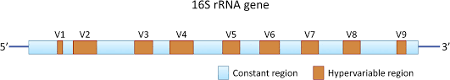






DNA amplicon metabarcoding
Metabarcoding is a method of producing massive taxonomic profiles of a given environmental samples using massive parallel sequencing on one targeted gene region
Sampling
DNA extraction
PCR amplification
Sequencing
bioinformatics
identification
Notes:
for example, 16S ribosomal RNA gene is the most favorite/ used gene to study bacterial microbiome. Reasons being, first, this gene is conservative, it is widely presented in all the bacteria genomes. Second, within its 1500bp length, there are 9 hv regions. Those hv regions are the key to differentiate species because the sequences within those regions differ by species. So you can design primers to amplify one or more hv regions or the whole 16S gene.

Slide 16
DNA amplicon metabarcoding cont’d
 | Sample1 | Sample2 | Sample3 | Sample4
ASV1 | 12 | 20 | 10 | 30
ASV2 | 1 | 0 | 0 | 0
ASV3 | 0 | 0 | 12 | 36
ASV4 | 10 | 12 | 9 | 8
ASV5 | 100 | 80 | 89 | 84
species1
species2
species3
species4
species5
Ways to mitigate sequencing errors that will influence taxonomy matching in the flowing steps.
ASV: amplicon sequence variant – reads corrected by the denoise method.
OTU: cluster your reads based on a certain similarity (i.e. 97%)
Notes:
one of the most important component in metabarcoding research is the abundance table.
This is what an abundance table looks like.
It quantifies how many OTU/ASVs in your samples.
To mitigate that Your reads can be clustered into otu (operational taxonomy unity), or denoise the sequence error in each read and generate ASVs (amplicon sequence variant).
ASV sequences and OUT seqenences will be further compared to a database, so to establish taxonomy connections.

Slide 17
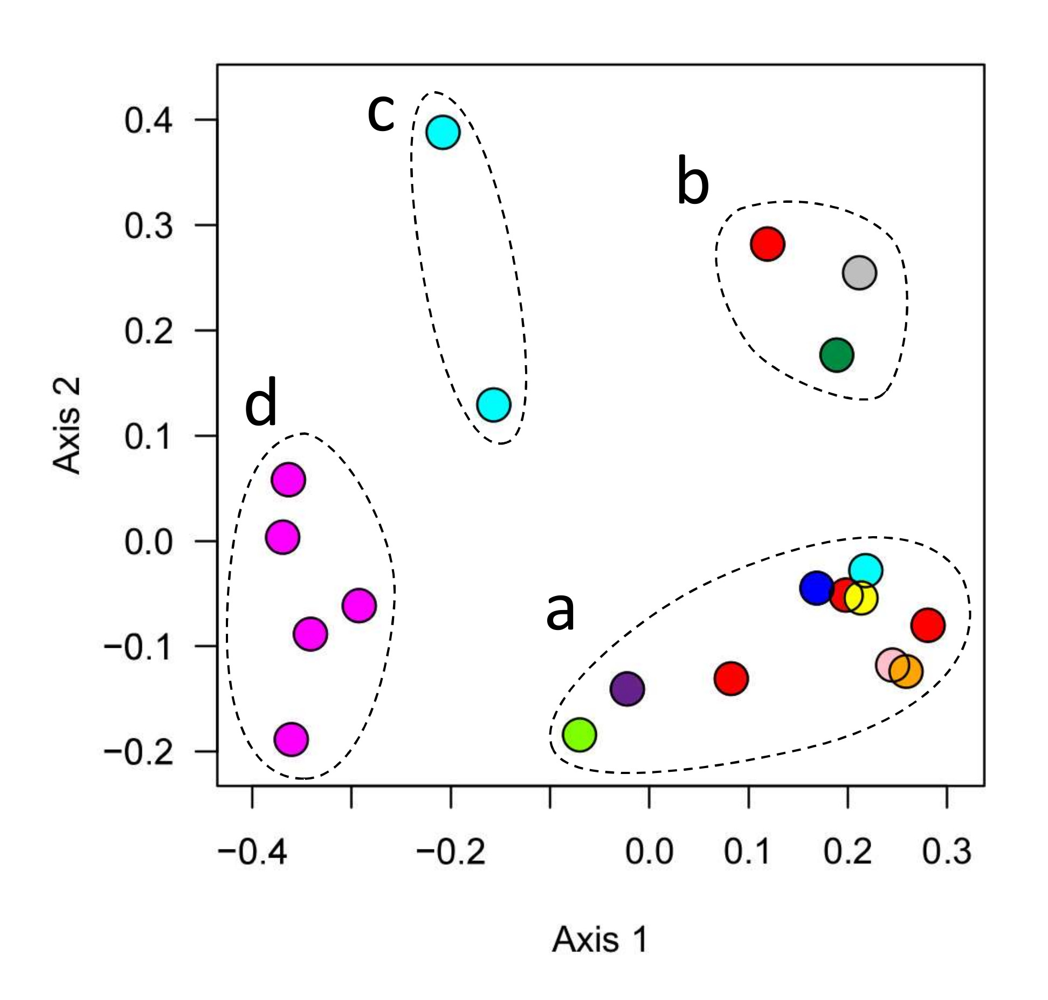
How does metabarcoding answer the big questions?
Community structure
Functional inference
alpha diversity
beta diversity
composition
keystone/network
Richness
Evenness
Similarity distance matrix
Taxonomic abundance barplot/heatmap
differential abundance
4 species
3
2
1
1
Notes:
With the abundance table, we can start to investigate the microbial community. Here we have adopted some ecology concepts to study community structure.
We first have alpha diversity, which is used to look at the diversity within one sample. Alpha diversity is reflected by the richness and the evenness in your sample.
Richness – how many species in the sample
Evenness – what proportion of each species in your sample (are they evenly distributed or dominated just by one species)
Beta diversity, to compare the diversity between samples. Usually it is measured as a similarity distance matrix and can be visualized as dimensionality-reduced plots (PCA, PCoA, NMDS, etc)
To know what species in your sample, we can look at the compositions, by making taxonomy barplot, heatmap,
To compared the relative abundance between two samples, we can perform differential abundance testing.
To build networks to investigate the keystone species
we can also infer functional profile from your data.

Slide 18
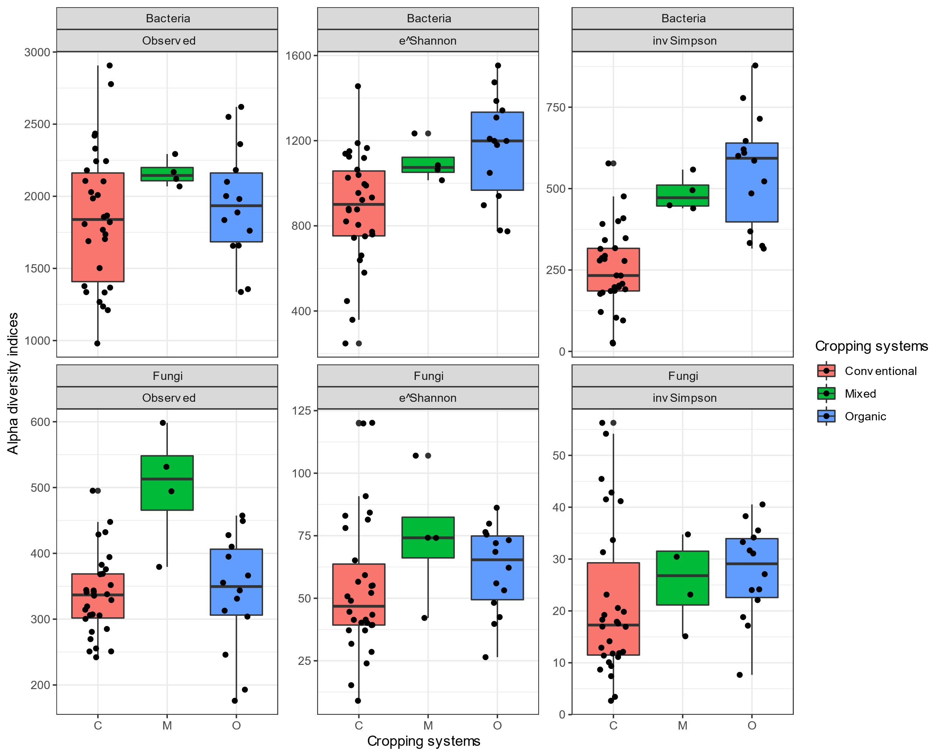
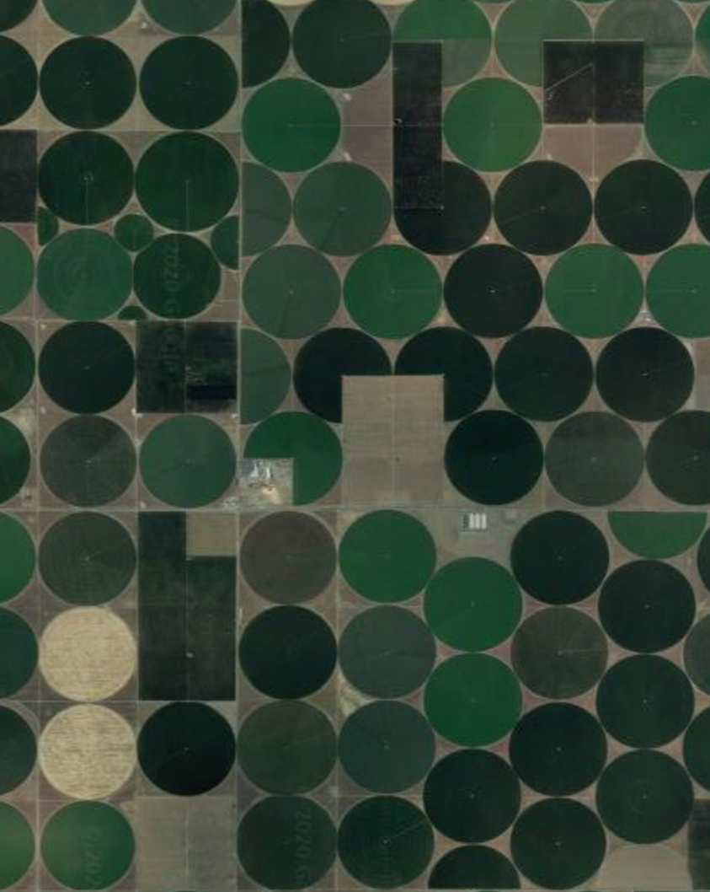
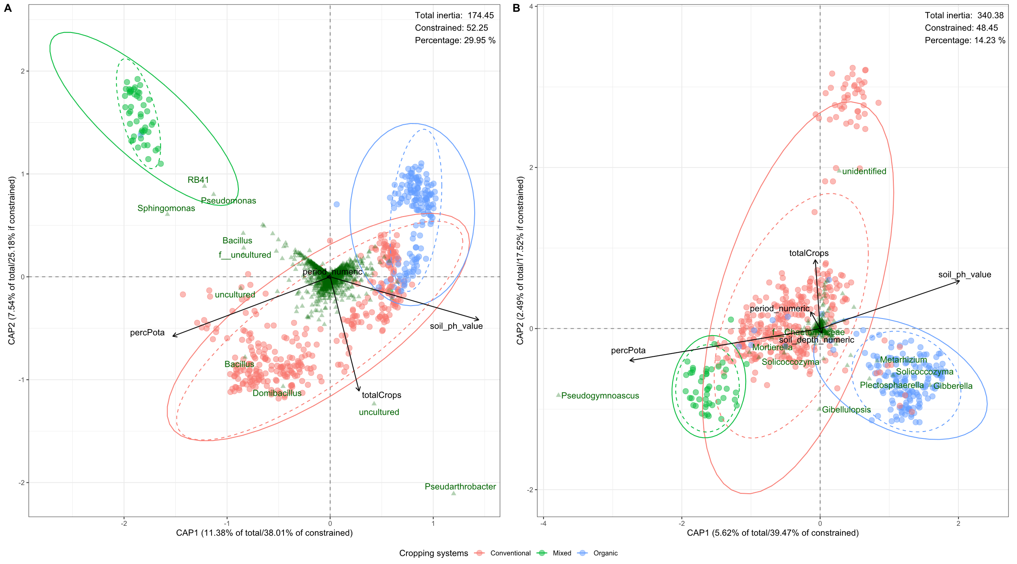
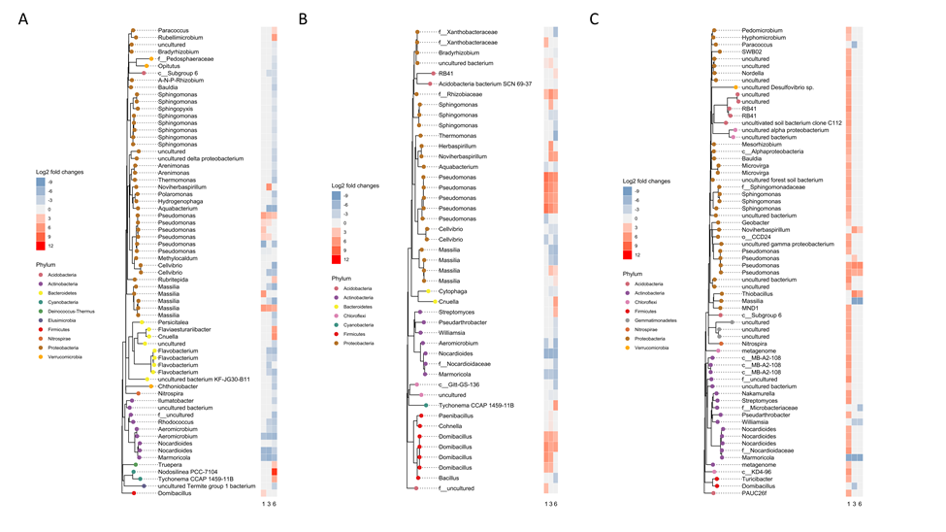
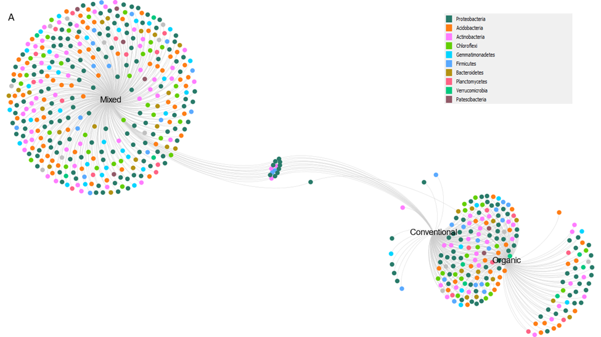
DNA metabarcoding example
taxonomic barplot
alpha diversity
differential abundance
beta diversity
indicator network
(Li et al., 2021 phytobiomes in review)
Notes:
In my previous postdoc project, we were interested in soil microbiome as a function of different agricultural managements in potato production. We conducted a survey study and a microcosm experiment. For the survey study, we collected soils from the farms in the region. We performed analyses on the alpha diversity, beta diversity, taxonomic barpot, indicator network, differential abundance testing . All these provide us different angles to assess how cropping systems impact the diversity and structure in bacterial and fungal communities. (The manuscript of this project is being under reviewing in the APS phytobiomes)

Slide 19
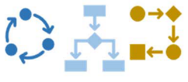
Shotgun metagenomics
In contrast to metabarcoding, shotgun metagenomics allows you to sequence all genomic DNA for a sample and profile taxonomy (species) and functions.
Taxonomic profile
Sampling
DNA extraction
Fragmentation
Sequencing
bioinformatics
Metabolic profile

Slide 20
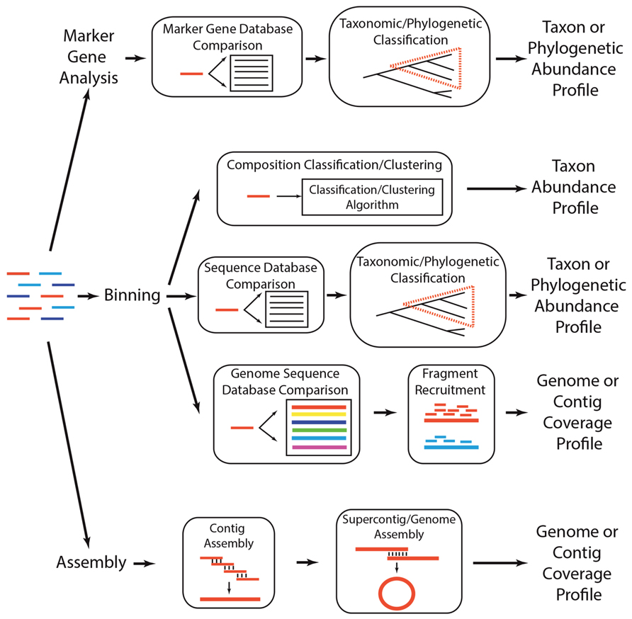
Shotgun metagenomics cont’d
Pros:
You’ll get a whole lot more than metabarcoding
Taxonomic resolution is more higher (species or strain level)
Accurate functional profiling
De novo – identify novel microorganism
Cons:
Deal with host contamination
Computational expensive
not as much depth
T. Sharpton Frontiers in Plant Science 2014

Slide 21
Future directions in phyllosphere microbiome study
Untangle the complex interactions of plant-microbiome-pathogen
meta-genome
meta-transcriptome
metabolome
move beyond cataloguing community to single-cell level
How can we capitalize our microbiome knowledge to the optimize/individualize plant or crop protection and production?
Notes:
Future microbiome studies will need to focus more at meta gene level, to untangle the complex interactions among the plant, the microbiome and the plant pathogens. And This field needs new technologies to allow us to switch from cataloguing communities to single cell level so we will be able to reveal true interactions.
We need to think about how to capitalize our microbiome knowledge so that we can optimize plant or crop protection and productvity. Because most of the time, green house research does not translate well into field trials. We also need to think about how to individualize microbiome application according to the plant/field properties and status.

Slide 22
Questions?
Notes:
I hope you enjoyed the talk.

Slide 23
The comparison
Targeted
Shotgun
Pros
Great depth
More precise
Only sequence a specific region
16s rRNA
18s for fungi
ITS and entire operon add more info
Cons
Unequal amplification
Only looks at one part of one gene (for rRNA/ITS sequencing)
Not enough resolution for species/subspecies identification
OTUs/ASVs instead
Impossible to directly assess microbe’s function
Pros
Can theoretically sequence 100% of sample
Greater resolution to genetic content
Can assess function
Identify novel organisms/genes/genomic features
Cons
Rarely sequence everything in sample
Not as much depth
Will sequence host/contaminant DNA
Very complex dataset
Computational exhaustive
$$$$
(Twaddle A. 2017)
Notes:
Unequal amplification --- therefore it does not always represent the true abundance

